Slide 1



Introduction to Azure Bot Services
Richard Fisher, Solutions Architect (Pramerica)
@
/in/

Slide 2
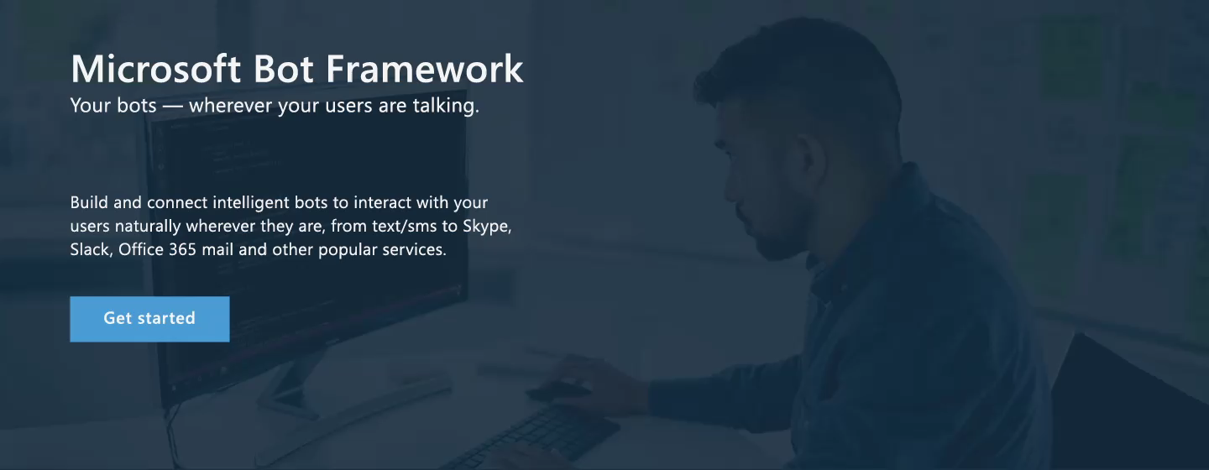
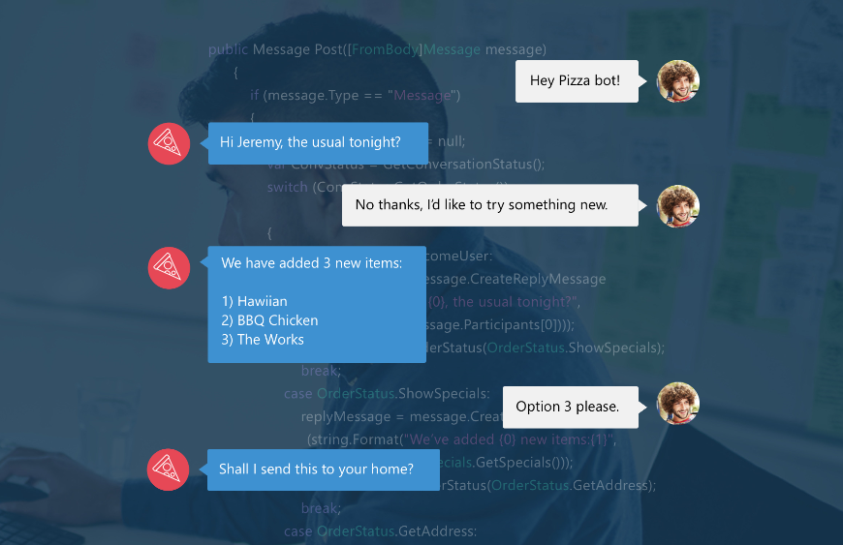
Bot Framework - Engage with your users
A natural language interface across all conversation channels
Insights
Operationalization
Provide information
Perform tasks
Make recommendations
Capture information

Slide 3
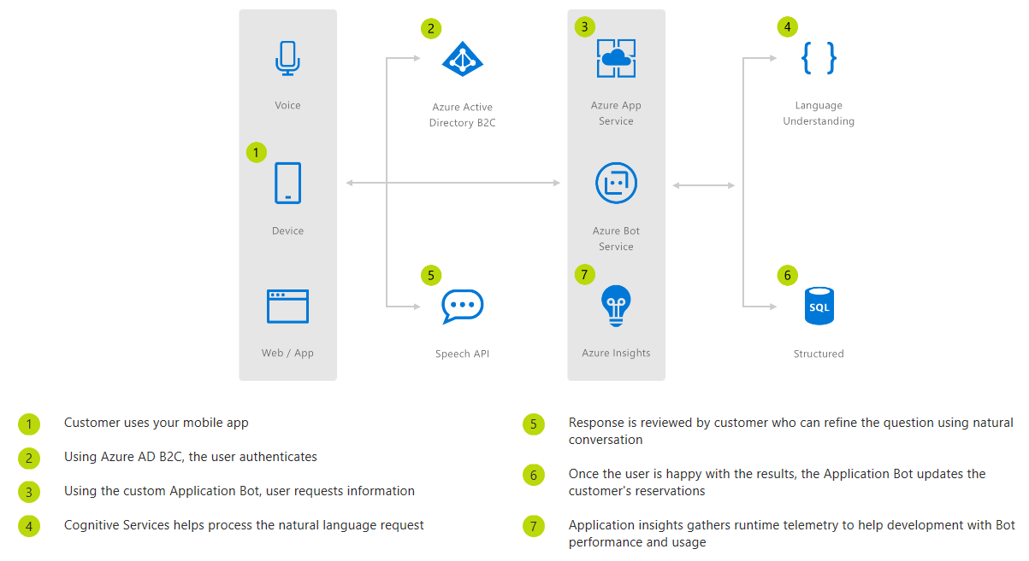
Commerce Chatbot

Slide 4
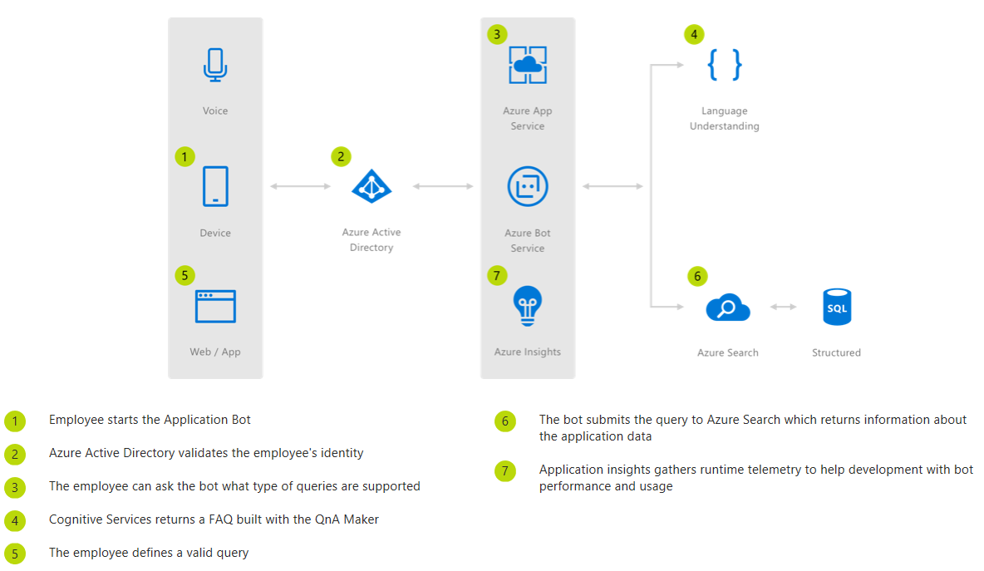
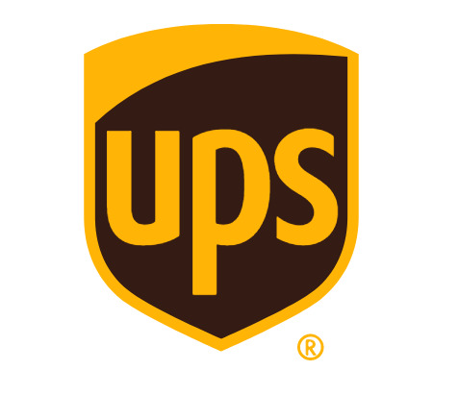
Informational Chatbot
This Informational Bot can answer questions defined in a knowledge set or FAQ using Cognitive Services QnA Maker and answer more open-ended questions using Azure Search.
"Conversation as a platform is the future, so it's great that we're already offering it to our customers using the Bot Framework and Azure."
Katie Duffy, Application Architect at UPS

Slide 5
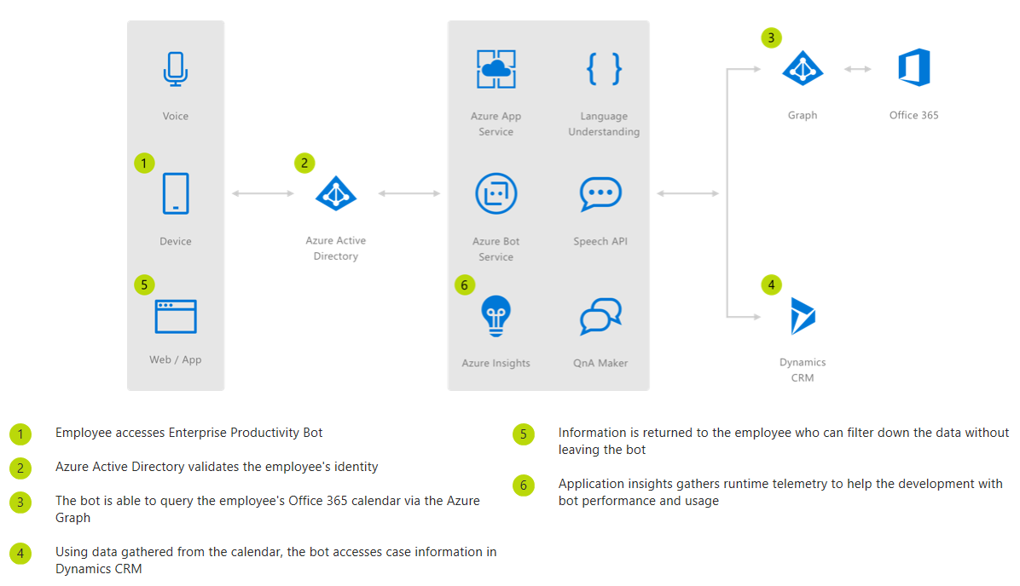
Enterprise Chatbot
“ Azure Bot Service can be easily combined with Language Understanding to build powerful enterprise productivity bots, allowing organizations to streamline common work activities by integrating external systems, such as Office 365 calendar, customer cases stored in Dynamics CRM and much more. “

Slide 6
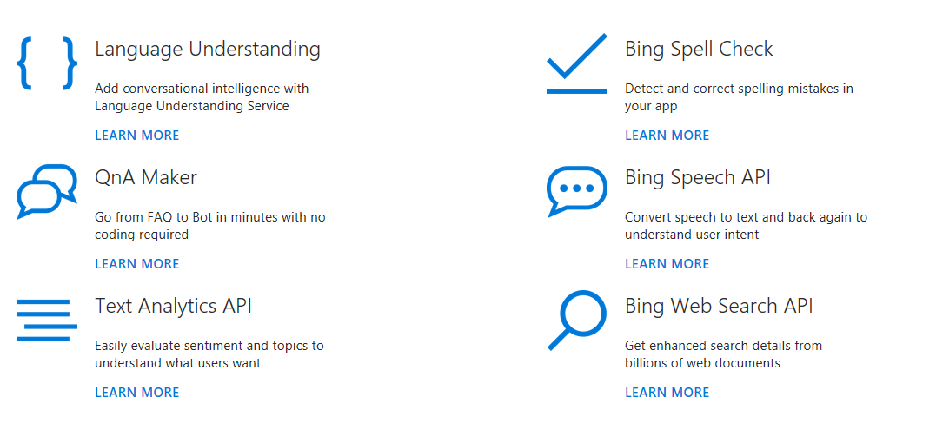
Building Intelligent Bots
Check out our comprehensive conversational AI framework for the development life cycle of your bot to create a simple bot and add sophisticated capabilities, such as speech, language understanding, QnA and more.

